Slide 1
Data Structures and Algorithms CSE 205
Lecture #0
The kick start session

Slide 2
Course Details
Course Code:- CSE 205
Course Name:- Data Structure and Algorithms
LTP:- 3 0 2 [3 lectures, 3 practical's/week]
Credits:- 4
Nature of Course:- Core

Slide 3
Course Outcomes
Understand the time and space complexity of programs and data structures.
Illustrate the importance of a Linked List in the context of real-world problems
Differentiate the Stack and Queue data structures for problem solving
Use of recursion in the iteration process and tree data structure
Apply heap operations and hashing techniques for efficient data storage, retrieval, and collision resolution.
Identify and integrating emerging data structures and algorithmic, ensuring their ability to stay with technological advancements and maintain professional growth in a dynamic field

Slide 4
Program Outcomes achieved from the course
Apply the knowledge of mathematics, science, engineering fundamentals, and an engineering specialization to the solution of complex engineering problems.
Identify, formulate, review research literature, and analyses complex engineering problems reaching substantiated conclusions using first principles of mathematics, natural sciences and engineering sciences.
Design solutions for complex engineering problems and design system components or processes that meet the specified needs with appropriate consideration for the public health and safety, and the cultural, societal, and environmental considerations.

Slide 5
Program Outcomes achieved from the course
Create, select, and apply appropriate techniques, resources, and modern engineering and IT tools including prediction and modelling to complex engineering activities with an understanding of the limitations.
Recognize the need for, and have the preparation and ability to engage in independent and lifelong learning in the broadest context of technological change.

Slide 6
Program Educational Objectives achieved from the course
Apply acquired skills in software engineering, networking, security, databases, intelligent systems, cloud computing and operating systems to adapt and deploy innovative software solutions for diverse applications.
Apply diverse IT skills to design, develop, and evaluate innovative solutions for business environments, considering risks, and utilizing interdisciplinary knowledge for efficient real-time projects benefiting society.

Slide 7
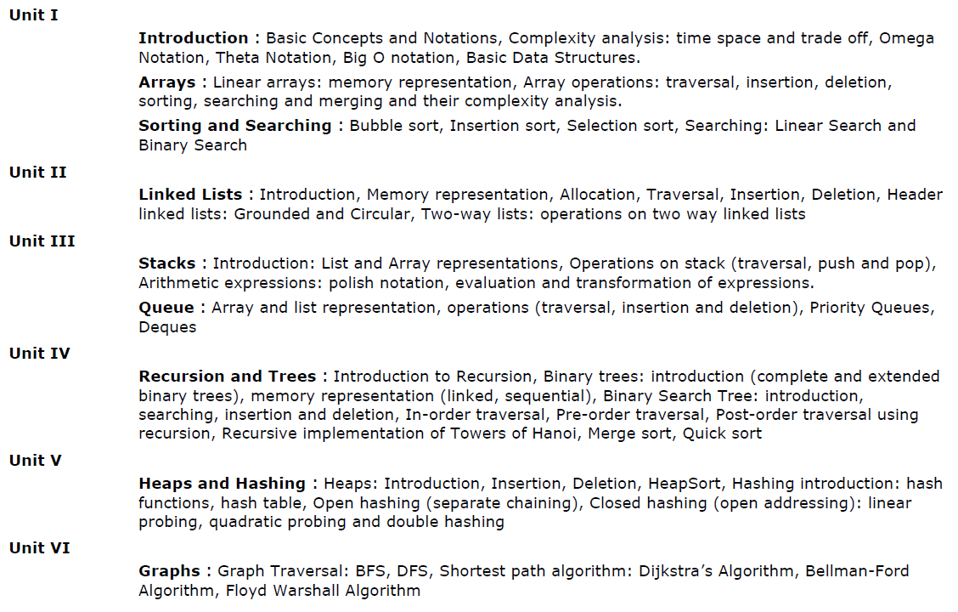
Syllabus – CSE205

Slide 8
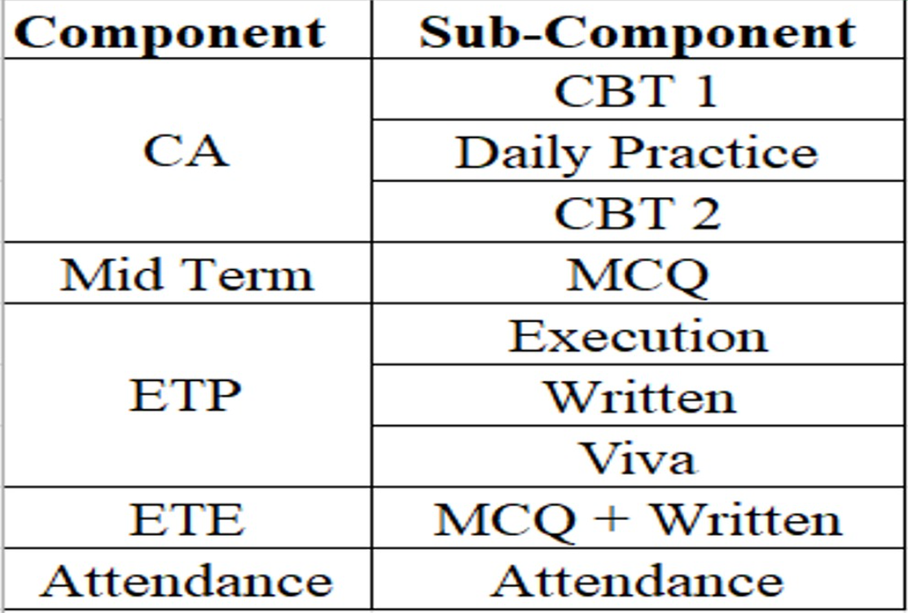
Tentative Course Assessment Model
Note: The above assessment structure is purely tentative and subject to change. The marks/weightage and detailed evaluation criteria for each sub-component will be communicated separately in due course.

Slide 9
Practice Problems
In the Practice Problems, marks are only for coding Problems.
MCQs are only for practice. No marks for MCQs.
In order to qualify for programming practice marks, the student must solve a minimum of 50% (50% Coding Problems + 50% MCQs) problems (eligibility condition)
Unit-wise Sequence locking

Slide 10
Daily Practice Problems
S. No | Unit | Question | Tentative Dates for Completion
1 | Unit-1 | At-least 15 Multiple Choice Questions and 21 Coding problems in each unit | 27th August 2026
2 | Unit-2 |  | 15th September 2026
3 | Unit-3 |  | 1st October 2026
4 | Unit-4 |  | 18th October 2026
5 | Unit-5 |  | 5th November 2026
6 | Unit-6 |  | 20th November 2026
Note:- Most Important for the improvement of Performance in Course Assessments.
21 coding questions in each unit divided into: - 6 Static Questions(solve within the class) - 15 Non-Static Questions(self-practice)

Slide 11
Important information
Programming practice- Student will complete it unit-wise on the IamNeo platform.
All code-based tests will be conducted on the IamNeo platform.
ETP will be conducted on the IamNeo platform.
URL: https://lpucolab438.examly.io/login
User Name: RegistrationNumber@neocolab.ai
Password: Registration Number

Slide 12
Why data structures?
Helps us to
get an idea of running time of algorithm
implement efficient algorithms
decide on hardware requirements
decide What is feasible vs. What is impossible
prepare job interviews

Slide 13
Skillset
Programming Skills
Logic building
Code analysis

Slide 14
MOOCs
Not Applicable

Slide 15
Recognition of Prior Learning (RPL) for Object Oriented Programming (Under EduRev)
The course “Data Structure and Algorithms" is included under the Recognition of Prior Learning (RPL) scheme offered by EduRev.

Slide 16
How RPL is Applicable
Under the EduRev RPL Framework, the following process is followed:
1. Eligibility for RPL
Learners who believe they already possess the skills and knowledge covered in the Data Structures and Algorithms course may apply for RPL within the specified timelines.
2. Assessment Process
Once the RPL application is accepted, the student will be required to appear for an RPL assessment/examination. This assessment is designed to evaluate the learner’s knowledge of Data Structures and Algorithms.

Slide 17
Interfaces and Contact Information
UMS link to apply for EDU Revolution initiatives:
UMS Navigation --- LMS → EDU Revolution: BE THE CHANGE
In case of any query in this regard, the student can approach for resolution through RMS at the following path:
UMS Navigation--- Relationship management system → EDU Revolution: BE THE CHANGE
OR get your queries resolved through the Helpline Number: 01824-520150.

Slide 18
Open Education Resources (OER)
Unit mapped | Broad topic | Sub Topic | Source Type | Source Title | *%age mapping (approx) | Source URL
Unit 1 | Arrays, Sorting and Searching | Array operations: traversal, insertion, deletion, sorting, searching | Reading material (online tutorial), Practice Questions | Learn Data Structures and Algorithms |DSA Tutorial | 70% | https://www.geeksforgeeks.org/array-data-structure/?ref=lbp
Unit 2 | Linked Lists | Introduction, Memory representation, Allocation, Traversal, Insertion, Deletion, | Reading material (online tutorial), Practice Questions | Learn Data Structures and Algorithms |DSA Tutorial | 80% | https://www.geeksforgeeks.org/data-structures/linked-list/?ref=lbp

Slide 19
Open Education Resources (OER)
Unit 3 | Stacks, Queue | Introduction: List and Array representations, Operations on stack (traversal, push and pop) | Reading material (online tutorial), Practice Questions | Learn Data Structures and Algorithms |DSA Tutorial | 60% | https://www.geeksforgeeks.org/stack-data-structure/?ref=lbp
Unit 4 | Trees, Recursion | Binary trees: introduction, searching, insertion and deletion, In-order traversal, Pre-order traversal, Post-order traversal using recursion | Reading material (online tutorial), Practice Questions | Learn Data Structures and Algorithms |DSA Tutorial | 70% | https://www.geeksforgeeks.org/introduction-to-tree-data-structure-and-algorithm-tutorials/?ref=lbp

Slide 20
Open Education Resources (OER)
Unit 5 | Heaps and Hashing | Heaps: Introduction, Insertion, Deletion, HeapSort, Hashing introduction: hash functions, hash table, Open hashing (separate chaining), Closed hashing (open addressing): linear probing, quadratic probing and double hashing | Reading material (online tutorial), Practice Questions | Learn Data Structures and Algorithms |DSA Tutorial | 50% | https://www.geeksforgeeks.org/dsa/hashing-data-structure/
Unit 6 | Graphs | Graph Traversal: BFS, DFS, Shortest path algorithm: Dijkstra’s Algorithm, Bellman-Ford Algorithm, Floyd Warshall Algorithm | Reading material (online tutorial), Practice Questions | Learn Data Structures and Algorithms |DSA Tutorial | 60% | https://www.geeksforgeeks.org/graph-data-structure-and-algorithms/?ref=lbp

Slide 21
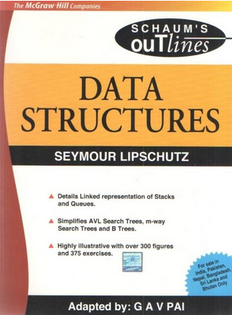
Text/Reference books
Books to Follow
Data Structures (Schaum’s Outlines Series) Author - Seymour Lipschutz
Data Structures And Algorithms
By Alfred V. Aho, Jeffrey D. Ullman
And John E. Hopcroft, Pearson

Slide 22

WHAT IS EDUCATION REVOLUTION?
Edu-Revolution at LPU is a transformative academic initiative aimed at creating a flexible, inclusive, and experiential learning environment.
Promotes student-centric learning by integrating real-world experiences, industry engagement, gamified learning practices, entrepreneurial activities, and extracurricular contributions into the formal academic framework.

Slide 23
Why EDU-Revolution!!!
Career Readiness
Enhance Real World Skills
Promote Innovation and Creativity
Foster Industry Relations
Develop Entrepreneurial Mindset
Increase Student Engagement and Motivation
Promote Lifelong Learning

Slide 24
Education Revolution: an approach that encourages…
Gamified Learning with AI focus - Learning Outside Classroom
Revenue Generation by Students
Career (not just degree)
Students in Decision Making

Slide 25
Pillar I: Gamified Learning with AI focus
50% Learning outside the classroom
50% attendance outside the classroom
50% grades outside the classroom
Formula: 50-50-50
Techniques of Learning Outside the Classroom
Projects
Technical Competitions & Hackathons
Social Media Presence
Recognition of Prior Learning
Paid Internship
Recruitment/Competitive/ Eligibility Examination
NPTEL/MOOCs
Community Service
Publications/Patents/ Copyrights

Slide 26
Gamified Learning: Benefits
Course Exemption
Grade Upgradation
No Pen-Paper based Evaluation
Attendance Relaxation
Duty Leaves
Value Addition in Academic Transcript

Slide 27
Pillar II: Revenue Generation
Where would Revenue Generation come from?
Industry/field consultancy projects
Freelancing activities
Paid internships
Establishing start- ups and entrepreneurial venture
Through University support:
Earn while Learn opportunities
Incentives for Publication/Patent/Copyright
You should be able to generate at least 50 % age of your semester fee every semester

Slide 28
Pillar II: Revenue Generation
Course Exemption/Grade upgradation
Student Centric Revenue Generation
Duty Leave
Important Points:
Submit authentic information only
Student must submit a detailed proposal outlining:
Revenue Model
Market Feasibility
Execution Strategy
Financial Projections
Earn exemptions from your revenue generation endeavors
Earn Academic benefits on revenues above 50,000 (in 6 months)

Slide 29
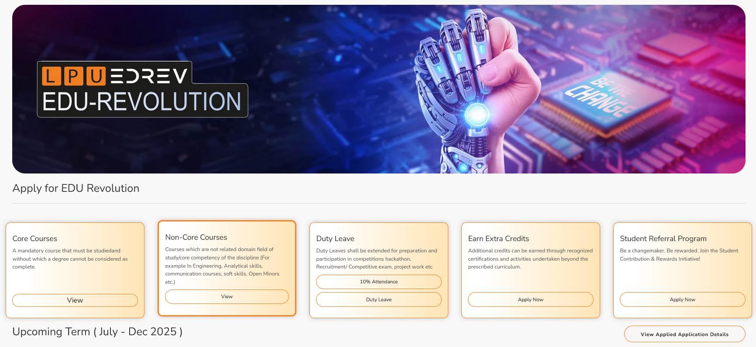
Where to View & Select Nomination Choices for Courses that students are studying
Step 1: Login to UMS -- Navigate to LMS -- EDREV: Be the Part of Change -- Options.

Slide 30
Applying for EDU-Revolution Initiatives
How can students apply:
Login UMS → LMS → EDU-Revolution: Be the Change → Apply for EDU- Revolution
Need Help:
Students can visit the EDU-Revolution Query & Assistance Zone at Block 27–102

Slide 31
Applying for EDU-Revolution Initiatives
Important Points
All student applications will be verified by the EDU-Revolution Standing Committee and the Committee may:
Contact you directly
Ask for supporting documents
Call for in-person interaction
Can approve/reject/change proposed benefits
Final decisions are based on merit, relevance & evidence

Slide 32
Pillar III: Career Pathway
"Your Journey, Your Choice: Build, Serve, or Study for Tomorrow!"
Corporate Jobs
Government
Jobs
Higher Studies
Entrepreneurship
Research
Study Abroad

Slide 33
Pillar III: Career Pathway
Career Pathways are at the core of our academic framework.
Curriculum is strategically designed to align with needs and requirements of each career pathway.
From technical proficiency to soft skills, the curriculum is tailored to develop a well-rounded professional ready for competitive market as per the chosen pathway.

Slide 34
Pillar III: Career Pathway
School Specific Success Stories for each pathway
(Highlighting student and their achievement for each pathway)

Slide 35
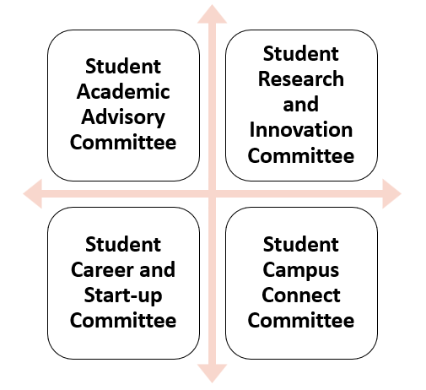
Pillar IV: Students in Decision Making
Committees under Student Education Revolution Board
We bring numerous ideas every year; but now, at least 20% of these ideas should originate from students themselves in all categories like academics, placements, research, entrepreneurship, etc.

Slide 36
Pillar IV: Students in Decision Making A platform to bring the Change
Curriculum
Content
New Teaching Methods
New Evaluation Methods
Academic Benefits
Research Area
Projects to Pursue
Funding opportunities
Identification of Real World Problems
Academic Benefits
National/International Internship
Bring New companies
International Placement opportunities
Entrepreneural Areas
Academic Benefits
Social Media Presence of Schools
Social Media Campaigns
Self Promotion
Academic Benefits

Slide 37

Zero Lecture Feedback
Please refrain from including your name or registration number in your feedback. Your honest and candid feedback are valued and appreciated. Kindly fill out the feedback separately for each subject.
Or Visit URL: https://forms.gle/pksSDrADkNLde4dBA Thank you !!!

Slide 38

Next Class: Basic Data Structures

